Slide 1
SQL PROJECT
BY RASHID GHANSAR

Slide 2
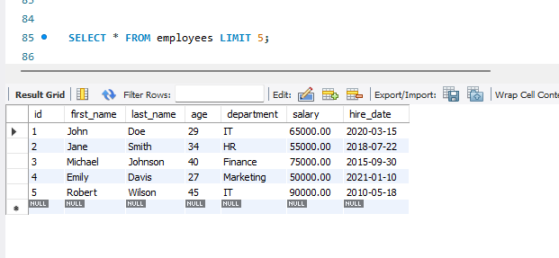
View the first 5 rows of the Employee table

Slide 3
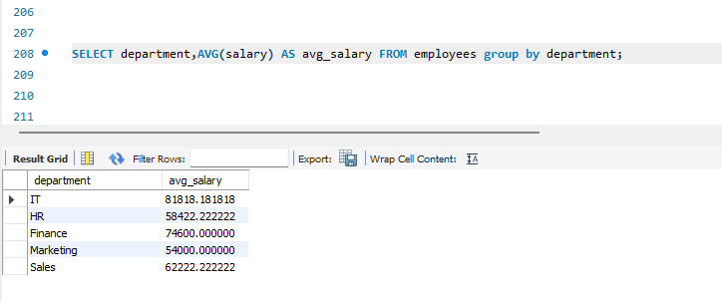
Find the Average Salary of employees
Group by department

Slide 4
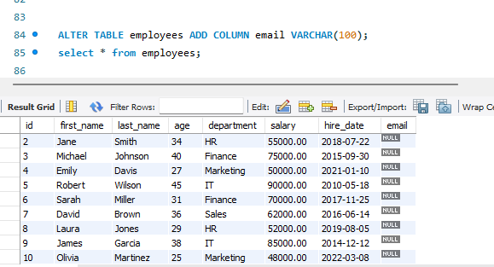
Modify the Employee table to add email to the table

Slide 5
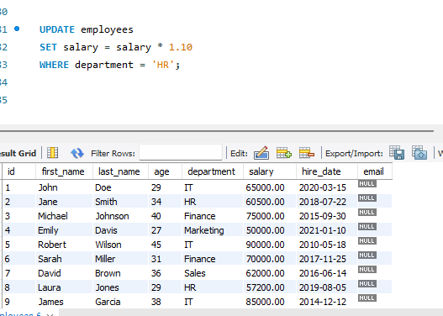
Update salary for employees in the 'HR' department by 10%

Slide 6
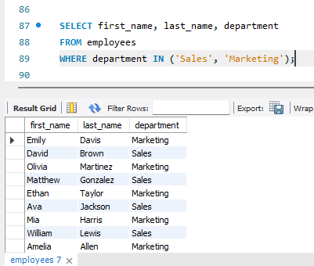
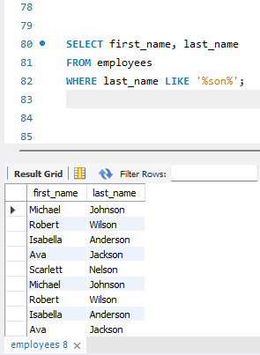
Filters employees working
in Sales or Marketing
Finds employees with 'son' in
their last name

Slide 7
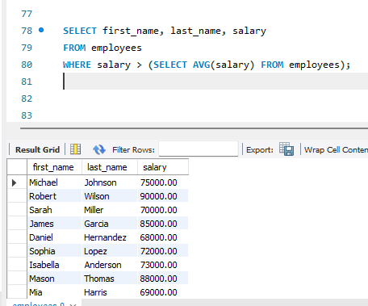
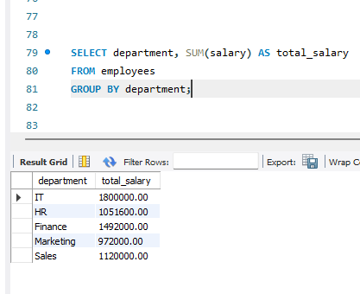
Finds employees earning above
the company’s average salary
Calculates total salaries
for each department

Slide 8
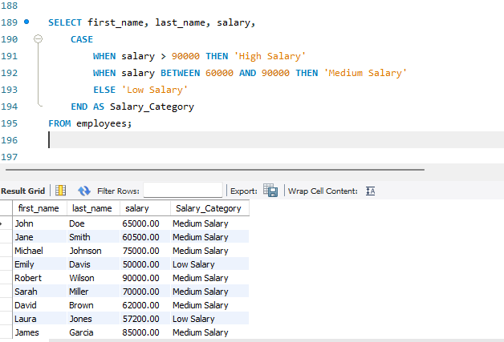
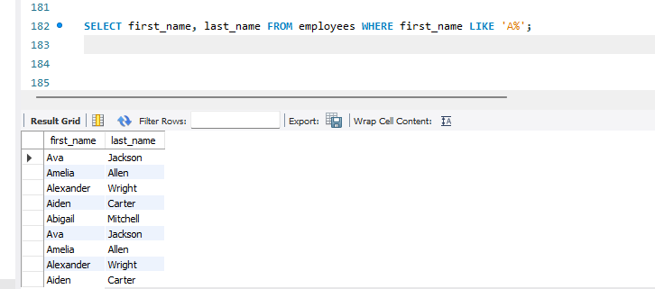
Use usecase to Categorize
Employees by Salary
Find Employees Whose Names Start with 'A'

Slide 9
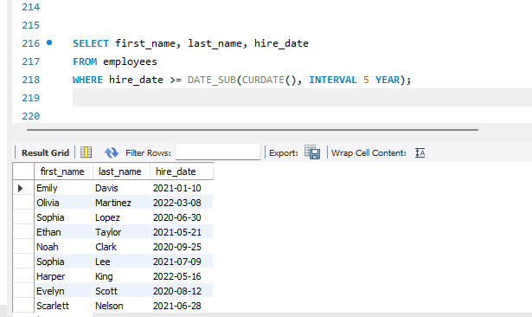
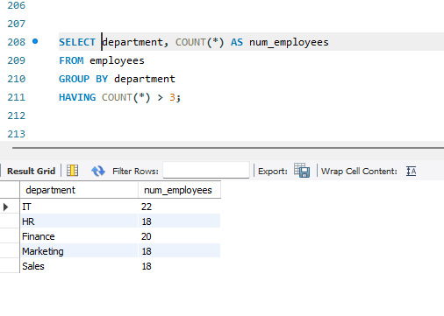
Find the number of employees
working in each department
Find Employees Hired in the Last 5 Years

Slide 10
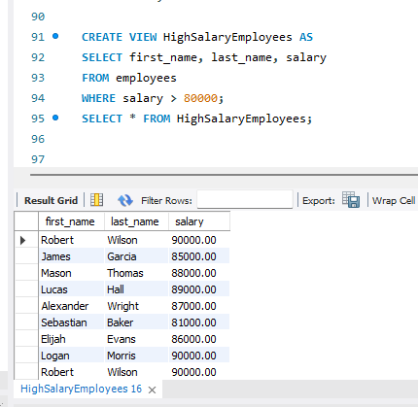
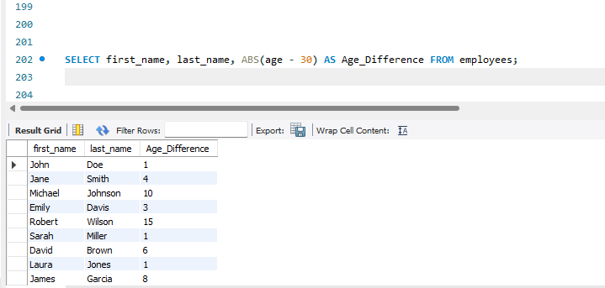
Creates a virtual table of employees
earning more than 80,000.
Calculate the Age Difference Between
Two Employees

